Slide 1
Understanding and Modeling Organizational Systems
2
Systems Analysis and Design, 8e
Kendall & Kendall

Slide 2
Learning Objectives
Understand that organizations and their members are systems and that analysts need to take a systems perspective.
Depict systems graphically using context-level data flow diagrams, and entity-relationship models, use cases, and use case scenarios.
Recognize that different levels of management require different systems.
Comprehend that organizational culture impacts the design of information systems.
Kendall & Kendall
Copyright © 2011 Pearson Education, Inc. Publishing as Prentice Hall
2-<number>

Slide 3
Three Main Forces Interacting to Shape Organizations
Levels of management
Design of organizations
Organizational cultures
Kendall & Kendall
Copyright © 2011 Pearson Education, Inc. Publishing as Prentice Hall
2-<number>

Slide 4
Organizations Are Composed of Interrelated Subsystems
Influenced by levels of management decision makers that cut horizontally across the organizational system
  Operations
  Middle management
  Strategic management
Influenced by organizational cultures and subcultures
Kendall & Kendall
Copyright © 2011 Pearson Education, Inc. Publishing as Prentice Hall
2-<number>

Slide 5
Major Topics
Organizations as systems
Depicting systems graphically
  Data flow diagram
  Entity-relationship model
  Use case modeling
Levels of management
Organizational culture
Kendall & Kendall
Copyright © 2011 Pearson Education, Inc. Publishing as Prentice Hall
2-<number>

Slide 6
Organizations as Systems
Conceptualized as systems designed to accomplish predetermined goals and objectives
Composed of smaller, interrelated systems serving specialized functions
Specialized functions are reintegrated to form an effective organizational whole.
Kendall & Kendall
Copyright © 2011 Pearson Education, Inc. Publishing as Prentice Hall
2-<number>
Notes:
To ascertain information requirements properly and to design appropriate information systems, it is of primary importance to understand the organization as a whole.
All systems are composed of subsystems

Slide 7
Interrelatedness and Independence of Systems
All systems and subsystems are interrelated and interdependent.
All systems process inputs from their environments.
All systems are contained by boundaries separating them from their environments.
System feedback for planning and control
An ideal system self-corrects or self-regulates itself.
Kendall & Kendall
Copyright © 2011 Pearson Education, Inc. Publishing as Prentice Hall
2-<number>
Notes:
When an element of a system is changed or eliminated, the rest of the system’s elements and subsystems are also significantly affected.
Processes change or transform inputs into outputs.
Typical processes include:
verifying
updating
printing
Organizational boundaries exist on a continuum ranging from extremely permeable (open) to almost impermeable (closed).
All organizations (systems) need planning and control to manage their resources effectively. Feedback is useful for planning and control.
The ideal system is one that self-corrects or self-regulates in such a way that decisions on typical occurrences are not required.

Slide 8
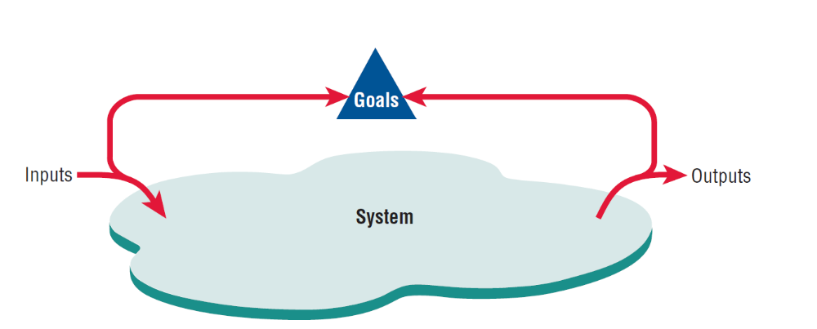
System Outputs Serve as Feedback that Compares Performance with Goals (Figure 2.1)
Kendall & Kendall
Copyright © 2011 Pearson Education, Inc. Publishing as Prentice Hall
2-<number>
Notes:
Feedback is received both internal and external to the organization. Anything external to an organization’s boundaries is considered to be an environment.

Slide 9
Organizational Environments
Community
  Physical location
  Demographic profile (education, income)
Economic
  Market factors
  Competition
Political
  State and local government
Legal
  Federal, state, regional, local laws, and guidelines
Kendall & Kendall
Copyright © 2011 Pearson Education, Inc. Publishing as Prentice Hall
2-<number>
Notes:
Numerous environments, with varying degrees of stability, constitute the milieu in which organizations exist.
Although changes in environment can be planned for, they cannot be directly controlled by the organization.

Slide 10
Openness and Closedness
Open
  Free flow of information
  Output from one system becomes input to another
Closed
  Restricted access to information
  Limited by numerous rules
  Information only on a “need to know” basis
Kendall & Kendall
Copyright © 2011 Pearson Education, Inc. Publishing as Prentice Hall
2-<number>
Notes:
Openness and closedness exist on a continuum, there is no such thing as an absolutely open or completely closed organization.

Slide 11
Virtual Organizations and Virtual Teams
A virtual organization has parts of the organization in different physical locations.
Computer networks and communications technology are used to bring virtual teams together to work on projects.
Kendall & Kendall
Copyright © 2011 Pearson Education, Inc. Publishing as Prentice Hall
2-<number>
Notes:
In some instances, organizations of remote workers have been able to succeed without the traditional investment in infrastructure.

Slide 12
Benefits of Virtual Organizations and Teams
Possibility of reducing costs of physical facilities
More rapid response to customer needs
Helping virtual employees to fulfill their familial obligations to children or aging parents
Kendall & Kendall
Copyright © 2011 Pearson Education, Inc. Publishing as Prentice Hall
2-<number>
Notes:
Just how important it will be to meet the social needs of virtual workers is still open to research and debate.

Slide 13
Taking a Systems Perspective
Allows system analyst to understand businesses before they begin their tasks
It is important that members of subsystems realize that they are interrelated with other subsystems.
Problems occur when each manager thinks that his/her department is the most important.
Bigger problems may occur when that manager rises through the ranks.
Kendall & Kendall
Copyright © 2011 Pearson Education, Inc. Publishing as Prentice Hall
2-<number>
Notes:
Taking a systems perspective allows systems analysts to start broadly clarifying and understanding the various businesses with which they will come into contact.
Without recognizing the interrelatedness of the subsystems; subsystems cannot properly accomplish their goals.
Managers of different subsystems need to have the same picture of the functioning and interrelatedness of the organization.
In his/her new position, the former manager may still think of his/her old department as the most important. The potential for this problem to occur exists in almost any business. If the analyst interviews this manager early on, he/she may get a distorted view of the company structure.

Slide 14
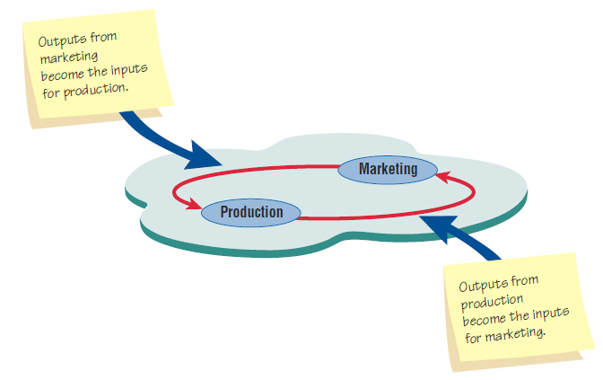
Taking a Systems Perspective (Figure 2.2)
Outputs from one department serve as inputs for another such
that subsystems are interrelated.
Kendall & Kendall
Copyright © 2011 Pearson Education, Inc. Publishing as Prentice Hall
2-<number>

Slide 15
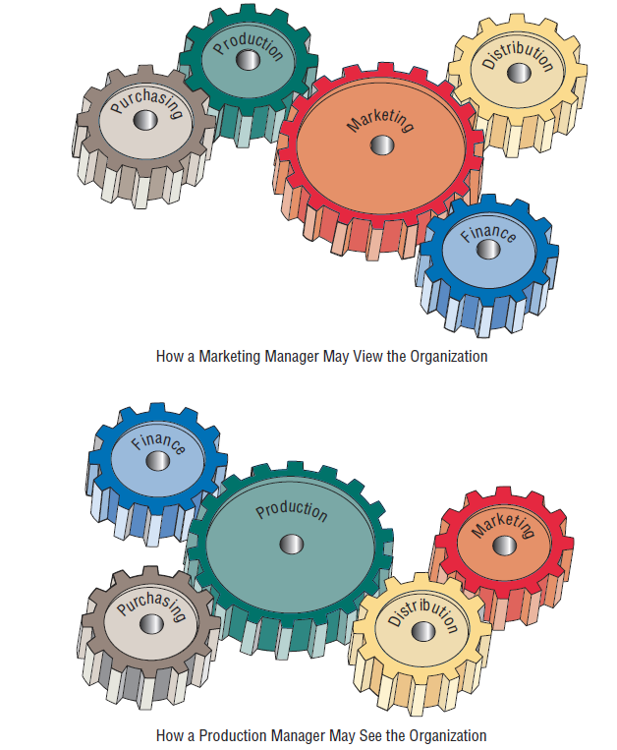
Perspective of Functional
Managers (FIGURE 2.3)
Kendall & Kendall
Copyright © 2011 Pearson Education, Inc. Publishing as Prentice Hall
2-<number>

Slide 16
Enterprise Resource Planning
Enterprise Systems or Enterprise Resource Planning (ERP) describes an integrated organizational information system.
Software that helps the flow of information between the functional areas within the organization
Kendall & Kendall
Copyright © 2011 Pearson Education, Inc. Publishing as Prentice Hall
2-<number>
Notes:
ERP systems include:
manufacturing components
sales and operations planning
distribution
managing the supply train
Problems with implementation:
difficult to analyze a system currently in use and then fit the ERP model to that system
companies tend to design their business processes before ERP is implemented
ERP, although growing in use is also being viewed with some skepticism.

Slide 17
Depicting Systems Graphically
Context-level data flow diagrams
Entity-relationship model
Use case modeling
Kendall & Kendall
Copyright © 2011 Pearson Education, Inc. Publishing as Prentice Hall
2-<number>
Notes:
The various graphical models show the boundaries of the system and the information used in the system.

Slide 18
Context-Level Data Flow Diagrams
Focus is on the data flowing into and out of the system and the processing of the data.
Shows the scope of the system:
  What is to be included in the system.
  The external entities are outside the scope of the system.
Kendall & Kendall
Copyright © 2011 Pearson Education, Inc. Publishing as Prentice Hall
2-<number>
Notes:
Sometimes called an environmental model.

Slide 19
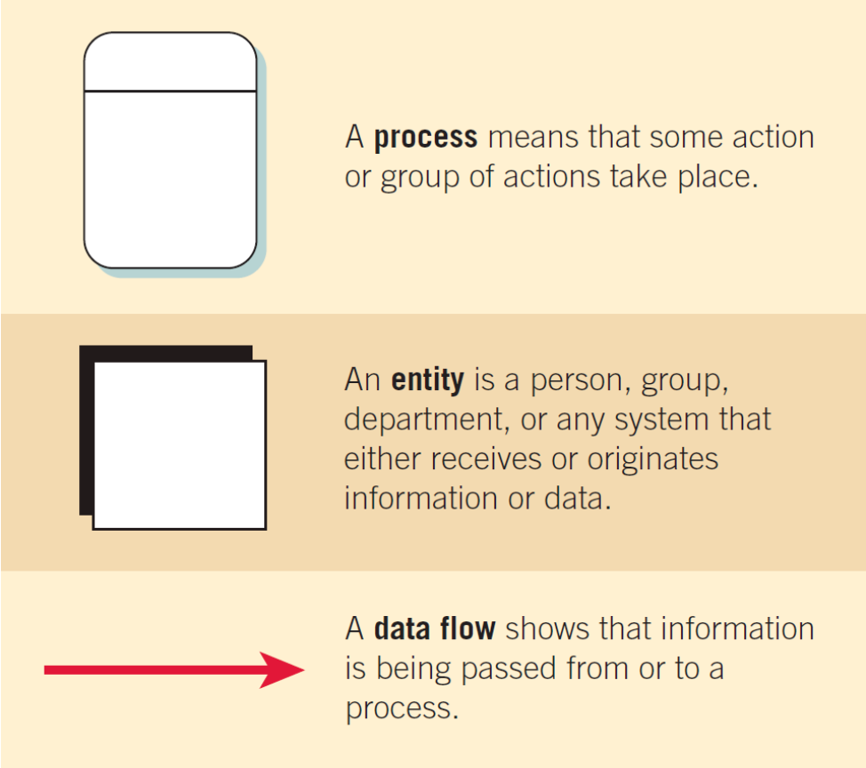
The Basic Symbols of a Data Flow Diagram (Figure 2.4)
Kendall & Kendall
Copyright © 2011 Pearson Education, Inc. Publishing as Prentice Hall
2-<number>
Notes:
Process - transforms incoming data into outgoing information, the content level has only one process representing the entire system.
Entity - Entity, a person, group, department, or system that supplies or receives information.
Data flows – the lines that connect external entities to the process.

Slide 20
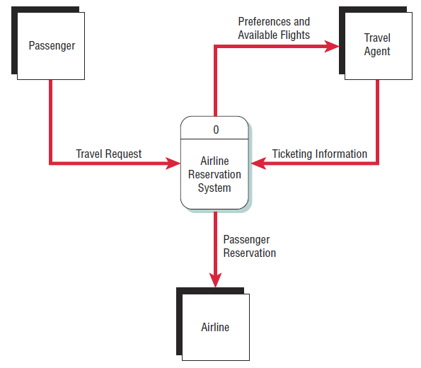
Airline Reservation System (Figure 2.5)
A context-level data flow diagram
for an airline reservation system
Kendall & Kendall
Copyright © 2011 Pearson Education, Inc. Publishing as Prentice Hall
2-<number>
Notes:
The passenger (an entity) initiates a travel request (data flow). The passenger’s preferences and the available flights are sent to the travel agent, who sends ticketing information back to the process. The passenger information is also sent to the airline.

Slide 21
Entity-Relationship Model
Focus is on the entities and their relationships within the organizational system
Another way to show the scope of a system
Kendall & Kendall
Copyright © 2011 Pearson Education, Inc. Publishing as Prentice Hall
2-<number>
Notes:
An entity may be a person, a place, thing, or an event.
A relationship is the association that describes the interaction among the entities.

Slide 22
Relationships
Relationships show how the entities are connected.
Three types of relationships:
  One-to-one
  One-to-many
  Many-to-many
Kendall & Kendall
Copyright © 2011 Pearson Education, Inc. Publishing as Prentice Hall
2-<number>
Notes:
One-to-one – one employee is assigned to one phone extension
One-to-many – many employees are assigned to a department.
Many-to-many – many passengers fly to many destinations.

Slide 23
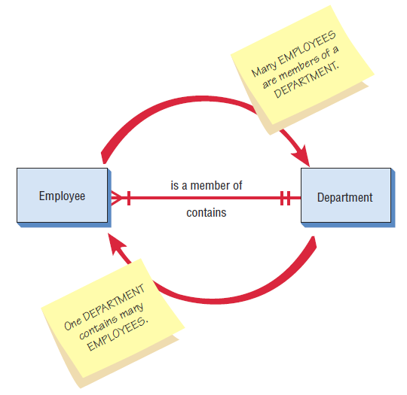
Entity-Relationship Example (Figure 2.7)
An entity-relationship diagram
showing a many-to-one
relationship
Kendall & Kendall
Copyright © 2011 Pearson Education, Inc. Publishing as Prentice Hall
2-<number>

Slide 24
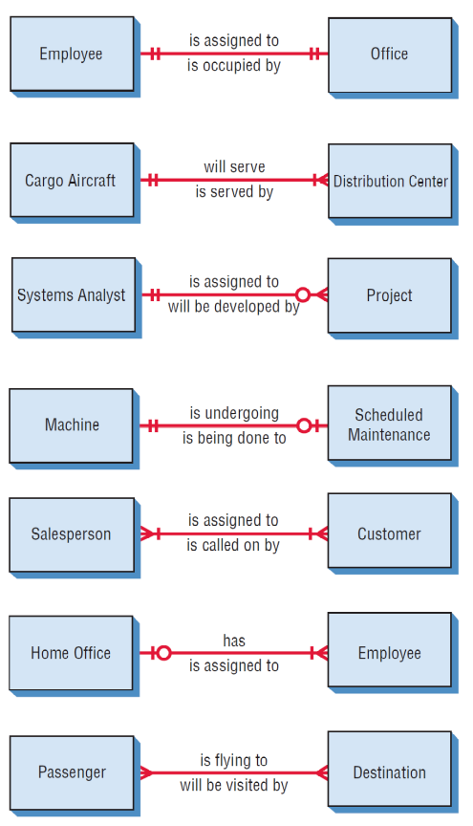
Examples of Different Types of Relationships in E-R Diagrams (Figure 2.8)
Kendall & Kendall
Copyright © 2011 Pearson Education, Inc. Publishing as Prentice Hall
2-<number>

Slide 25
Entities
Fundamental entity
Associative entity
Attributive entity
Kendall & Kendall
Copyright © 2011 Pearson Education, Inc. Publishing as Prentice Hall
2-<number>

Slide 26
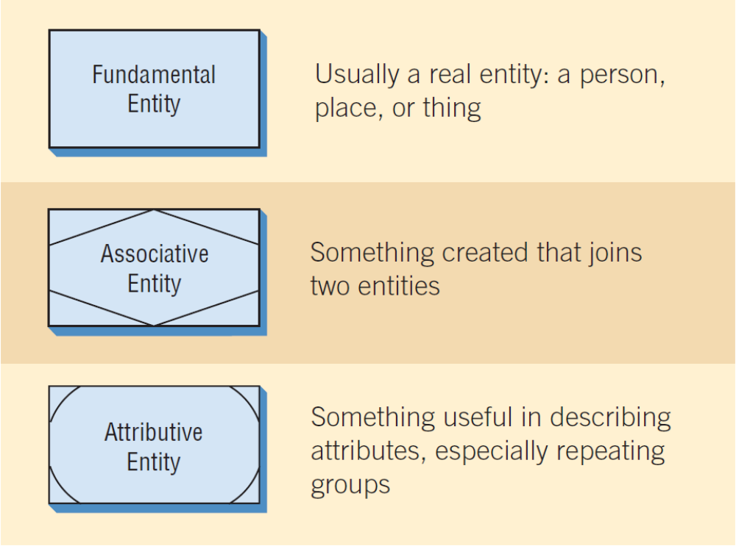
Three Different Types of Entities Used in E-R Diagrams (Figure 2.9)
Kendall & Kendall
Copyright © 2011 Pearson Education, Inc. Publishing as Prentice Hall
2-<number>
Notes:
Different symbols are used to represent different types of entities.
An associative entity can only exist if it is connected to at least two other entities.
An attributive entity is used when we want to show data that are completely dependent on the existence of an fundamental entity.

Slide 27
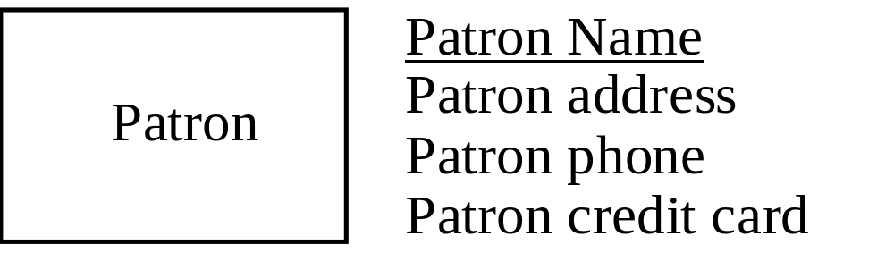
Attributes
Data attributes may be added to the diagram.
Kendall & Kendall
Copyright © 2011 Pearson Education, Inc. Publishing as Prentice Hall
2-<number>
Notes:
Data attributes are what make up or define the entity.

Slide 28
Creating Entity-Relationship Diagrams
List the entities in the organization.
Choose key entities to narrow the scope of the problem.
Identify what the primary entity should be.
Confirm the results of the above through data gathering.
Kendall & Kendall
Copyright © 2011 Pearson Education, Inc. Publishing as Prentice Hall
2-<number>
Notes:
ER diagrams are generally used to model the database.
ER diagrams help the analyst understand what business the organization is actually in, determine the size of the problem, and discern whether the right problem is being addressed. The E-R diagram needs to be confirmed or revised as the data-gathering process takes place.

Slide 29
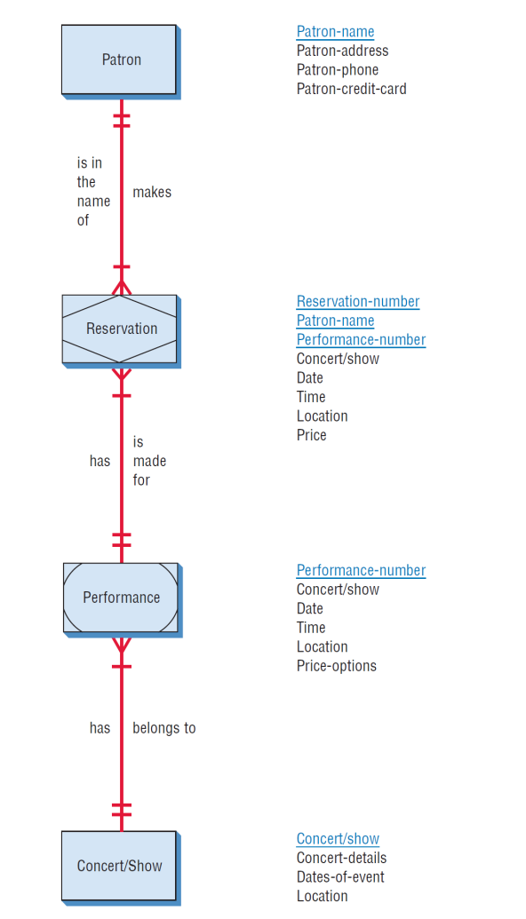
A More Complete E-R Diagram Showing Data Attributes of the Entities (Figure 2-12 )
Kendall & Kendall
Copyright © 2011 Pearson Education, Inc. Publishing as Prentice Hall
2-<number>

Slide 30
Use Case Modeling
Describes what a system does without describing how the system does
  A logical model of the system
Use case is a view of the system requirements
Analyst works with business experts to develop requirements
Kendall & Kendall
Copyright © 2011 Pearson Education, Inc. Publishing as Prentice Hall
2-<number>
Notes:
Originally introduced as a diagram for use in the object-oriented UML, use cases are now being used regardless of the approach to systems development. It can be used as part of the SDLC or in agile modeling.

Slide 31
Use Case Diagram
Actor
  Refers to a particular role of a user of the system
  Similar to external entities; they exist outside of the system
Use case symbols
  An oval indicating the task of the use case
Connecting lines
  Arrows and lines used to diagram behavioral relationships
Kendall & Kendall
Copyright © 2011 Pearson Education, Inc. Publishing as Prentice Hall
2-<number>
Notes:
A use case always describes three things: an actor that initiates an event; the event that triggers a use case; and the use case that performs the actions triggered by the event.

Slide 32
Actor
Divided into two groups
  Primary actors:
    Supply data or receive information from the system.
    Provide details on what the use case should do.
  Supporting actors:
    Help to keep the system running or provide help.
    The people who run the help desk, the analysts, programmers, and so on.
Kendall & Kendall
Copyright © 2011 Pearson Education, Inc. Publishing as Prentice Hall
2-<number>
Notes:
Sometimes a table is created with actor profiles that lists the actors, their background, and their skills.
These profiles can be useful to understand how the actor interacts with the system.

Slide 33
A Use Case Always Provides Three Things
An actor that initiates an event
The event that triggers a use case
The use case that performs the actions triggered by the event
Kendall & Kendall
Copyright © 2011 Pearson Education, Inc. Publishing as Prentice Hall
2-<number>
Notes:
A use case documents a single transaction or event.
An event is an input to the system that happens at a specific time and place and causes the system to do something.

Slide 34
Use Case Relations
Behavioral relationships
  Communicates
    Used to connect an actor to a use case
  Includes
    Describes the situation in which a use case contains behavior that is common to more than one use case
Kendall & Kendall
Copyright © 2011 Pearson Education, Inc. Publishing as Prentice Hall
2-<number>

Slide 35
Use Case Relations
Behavioral relationships (continued)
  Extends
    Describes the situation in which one use case possesses the behavior that allows the new case to handle a variation or exception from the basic use case
  Generalizes
    Implies that one thing is more typical than the other thing
Kendall & Kendall
Copyright © 2011 Pearson Education, Inc. Publishing as Prentice Hall
2-<number>

Slide 36
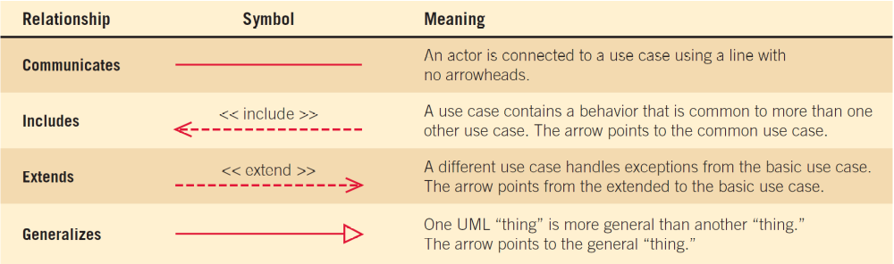
Some Components of Use Case Diagrams Showing Actors, Use Cases, and Relationships for a Student Enrollment Example (Figure 2.13)
Kendall & Kendall
Copyright © 2011 Pearson Education, Inc. Publishing as Prentice Hall
2-<number>

Slide 37
Examples of Use Cases, Behavioral Relationships for Student Enrollment (Figure 2.14)
Kendall & Kendall
Copyright © 2011 Pearson Education, Inc. Publishing as Prentice Hall
2-<number>
Notes:
Communicates – used to connect an actor to a use case. The task of the use case is to give some sort of result that is beneficial to the actor in the system.
Includes – describes the situation in which a use case contains behavior that is common to more than one use case.
Extends - describes the situation in which one use case possesses the behavior that allows the new use case to handle a variation or exception from the basic use case.
Generalizes – implies that one thing is more typical than the other thing.

Slide 38
Scope
System scope defines its boundaries:
  What is in or outside the system
  Project has a budget that helps to define scope
  Project has a start and an end time
Actors are always outside of scope
Communication lines are the boundaries and define the scope
Kendall & Kendall
Copyright © 2011 Pearson Education, Inc. Publishing as Prentice Hall
2-<number>

Slide 39
Developing Use Case Diagrams
Review the business specifications and identify the actors involved.
May use agile stories.
Identify the high-level events and develop the primary use cases that describe those events and how the actors initiate them.
Review each primary use case to determine the possible variations of flow through the use case.
The context-level data flow diagram could act as a starting point for creating a use case.
Kendall & Kendall
Copyright © 2011 Pearson Education, Inc. Publishing as Prentice Hall
2-<number>
Notes:
When diagramming a use case, start by asking the users to list everything the system should do for them.

Slide 40
A Use Case Diagram Representing a System Used to Plan a Conference (Figure 2.15 )
Kendall & Kendall
Copyright © 2011 Pearson Education, Inc. Publishing as Prentice Hall
2-<number>
Notes:
Example of a use case diagram representing a system used to plan a conference.

Slide 41
Developing the Use Case Scenarios
The description of the use case
Three main areas:
  Use case identifiers and initiators
  Steps performed
  Conditions, assumptions, and questions
Kendall & Kendall
Copyright © 2011 Pearson Education, Inc. Publishing as Prentice Hall
2-<number>
Notes:
Each use case has a description referred to as the use case scenario.

Slide 42
A Use Case Scenario Is Divided into Three Sections (Figure 2.16)
Use case name: Register for Conference |  | UniqueID: Conf RG 003
Area: Conference Planning
Actor(s): Participant
Stakeholder Conference Sponsor, Conference Speakers
Level Blue
Description: Allow conference participant to register online for the conference using a secure Web site.
Triggering Event: Participant uses Conference Registration Web site, enters userID and password, and clicks the logon button.
Trigger type:  External  Temporal
Steps Performed (Main Path) | Information for Steps
1. Participant logs in using the secure Web server | userID, Password
More steps included here…
12. Successful Registration Confirmation Web page is sent to the participant | Registration Record Confirmation Number
Preconditions: Participant has already registered and has created a user account.
Postconditions: Participant has successfully registered for the conference.
Assumptions: Participant has a browser and a valid userID and password.
Success Guarantee: Participant has registered for the conference and is enrolled in all selected sessions.
Minimum Guarantee: Participant was able to logon.
Requirements Met: Allow conference participants to be able to register for the conference using a secure Web site.
Outstanding Issues: How should a rejected credit card be handled?
Priority: High
Risk: Medium
Kendall & Kendall
Copyright © 2011 Pearson Education, Inc. Publishing as Prentice Hall
2-<number>
Notes:
(First area)
Use case identifiers and initiators – orients the reader and contains:
1. The use case name and a unique ID
2. The application area or system that this use case belongs to
3. The actors involved in the use case
4. A brief description of what the use case accomplishes
5. The triggering event
6. Type of trigger - external or temporal
external – those started by an actor
temporal – triggered or started by time
7. May list stakeholders
(Second area)
Includes the steps performed, and the information required for each of the steps.
(Third area)
Preconditions
Post conditions
Assumptions
Outstanding issues
optional statement of priority
optional statement of risk

Slide 43
Use Case Header Area
Has a name and a unique ID.
Include application area.
List actors.
Include stakeholders.
Include the level.
Has a brief description of the use case.
Kendall & Kendall
Copyright © 2011 Pearson Education, Inc. Publishing as Prentice Hall
2-<number>

Slide 44
Use Case Levels
Use case levels describe how global or detailed the use case description is:
  White (like clouds): enterprise level
  Kite: business unit or department level
  Blue (sea level): user goals
  Indigo (or fish): functional or subfunctional
  Black (or clam): most detailed
Kendall & Kendall
Copyright © 2011 Pearson Education, Inc. Publishing as Prentice Hall
2-<number>

Slide 45
Alternative Scenarios
Extensions or exceptions to the main use case
Number with an integer, decimal point, integer
Steps that may or may not always be used
Kendall & Kendall
Copyright © 2011 Pearson Education, Inc. Publishing as Prentice Hall
2-<number>

Slide 46
Use Case Footer Area
Preconditions—need to be met before use case can be performed
Postconditions or the state of the system after the use case has finished
Assumptions
Minimal guarantee
Success guarantee
Outstanding issues
Optional priority and risk
Kendall & Kendall
Copyright © 2011 Pearson Education, Inc. Publishing as Prentice Hall
2-<number>

Slide 47
Four Steps Used to Create Use Cases
Use agile stories, problem definition objectives, user requirements, or a features list.
Ask about the tasks that must be done.
Determine if there are any iterative or looping actions.
The use case ends when the customer goal is complete.
Kendall & Kendall
Copyright © 2011 Pearson Education, Inc. Publishing as Prentice Hall
2-<number>

Slide 48
Why Use Case Diagrams Are Helpful
Identify all the actors in the problem domain.
Actions that need to be completed are also clearly shown on the use case diagram.
The use case scenario is also worthwhile.
Simplicity and lack of technical detail
Kendall & Kendall
Copyright © 2011 Pearson Education, Inc. Publishing as Prentice Hall
2-<number>
Notes:
Identify all the actors in the problem domain – the systems analyst can concentrate on what humans want and need to use the system, extent their capabilities, and enjoy their interaction with technology.
Actions that need to be completed are also clearly shown on the use case diagram – this makes it easy for the analyst to identify processes and aids in communication with other analysts on the team and business executives
The use case scenario is also worthwhile – since a lot of the information the users impart to the analysts are in story form, it is easy to capture on the use case scenario form.
Simplicity and lack of technical detail – used to show the scope of a system, along with the major features of the system and the actors that work with those major features.

Slide 49
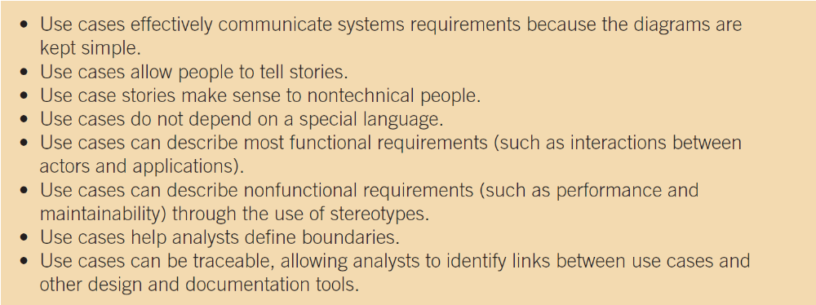
The Main Reasons for Writing Use Cases Are Their Effectiveness in Communicating with Users and Their Capturing of User Stories (Figure 2.18)
Kendall & Kendall
Copyright © 2011 Pearson Education, Inc. Publishing as Prentice Hall
2-<number>

Slide 50
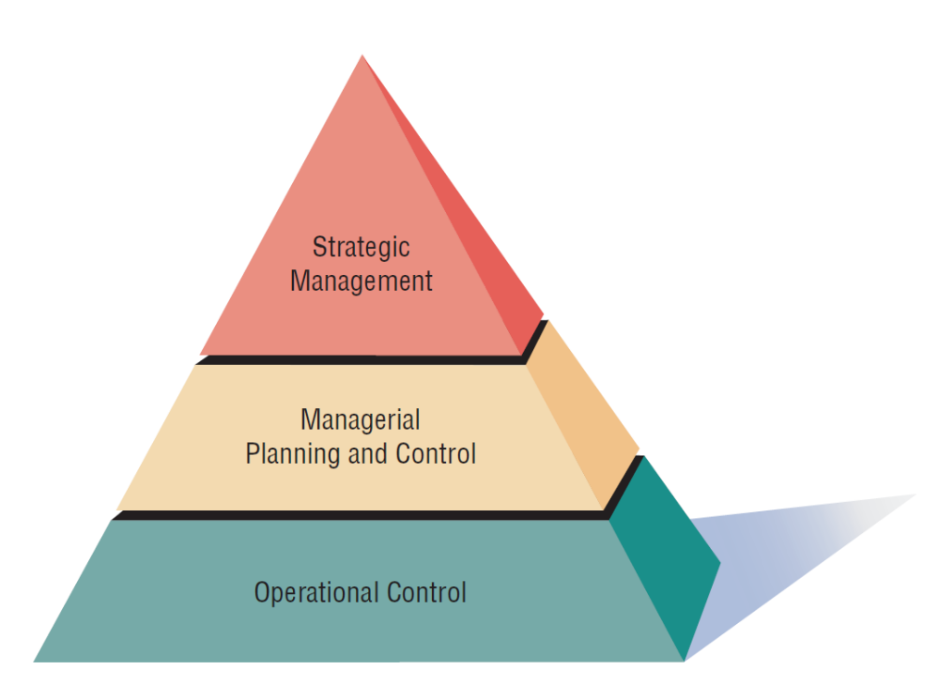
Management in Organizations Exists on Three Horizontal Levels: Operational Control, Managerial Planning and Control, and Strategic Management (Figure 2.19)
Kendall & Kendall
Copyright © 2011 Pearson Education, Inc. Publishing as Prentice Hall
2-<number>
Notes:
Management in organizations exists on three broad, horizontal levels. Each level carries its own responsibilities, and all work toward achieving organizational goals and objectives in their own ways.

Slide 51
Operations Control
Make decisions using predetermined rules that have predictable outcomes.
Oversee the operating details of the organization.
Kendall & Kendall
Copyright © 2011 Pearson Education, Inc. Publishing as Prentice Hall
2-<number>
Notes:
Forms the bottom tier of the three-tiered model.

Slide 52
Managerial Planning and Control
Make short-term planning and control decisions about resources and organizational objectives.
Decisions may be partly operational and partly strategic.
Kendall & Kendall
Copyright © 2011 Pearson Education, Inc. Publishing as Prentice Hall
2-<number>
Notes:
Forms the second or intermediate tier of the three-tiered model.

Slide 53
Strategic Management
Look outward from the organization to the future.
Make decisions that will guide middle and operations managers.
Work in highly uncertain decision-making environment.
Define the organization as a whole.
Kendall & Kendall
Copyright © 2011 Pearson Education, Inc. Publishing as Prentice Hall
2-<number>
Notes:
Third level of the three-tiered model.

Slide 54
Managerial Levels
Different organization structure
Leadership style
Technological considerations
Organization culture
Human interaction
All carry implications for the analysis and design of information systems
Kendall & Kendall
Copyright © 2011 Pearson Education, Inc. Publishing as Prentice Hall
2-<number>
Notes:
Operations managers:
need internal information that is of a repetitive, low-level nature.
highly dependent on information that captures current performance
large users of online, real-time information resources
need for past performance information and periodic information is moderate
have little use for external information that allows future projections
Middle management:
in need of both short and longer-term information
need for information in real time
need current information on performance as measured against set standards
highly dependent on internal information
need for historical information, along with information that allows prediction of future events
Strategic management:
highly dependent on information from external sources that supply news of market trends and the strategies of competing corporations.
high need for information of a predictive nature
need for periodically reported information

Slide 55
Organizational Culture
Organizations have cultures and subcultures.
Learn from verbal and nonverbal symbolism.
Kendall & Kendall
Copyright © 2011 Pearson Education, Inc. Publishing as Prentice Hall
2-<number>
Notes:
We need to think of organizations as hosts to multiple, often competing subcultures.
Competing subcultures may be in conflict, attempting to gain adherents to their vision of what the organization should be.
Verbal symbolism – includes shared language used to construct, convey, and preserve subculture myths, metaphors, visions, and humor.
Nonverbal symbolism – includes shared artifacts, rites, and ceremonies.
Understanding and recognizing predominant organizational subcultures may help the systems analyst overcome the resistance to change that arises when a new information system is installed.

Slide 56
Verbal Symbolism
Myths
Metaphors
Visions
Humor
Kendall & Kendall
Copyright © 2011 Pearson Education, Inc. Publishing as Prentice Hall
2-<number>

Slide 57
Nonverbal Symbolism
Shared artifacts
  Trophies, etc.
Rites and rituals
  Promotions
  Birthdays, etc.
Clothing worn
Office placement and decorations
Kendall & Kendall
Copyright © 2011 Pearson Education, Inc. Publishing as Prentice Hall
2-<number>

Slide 58
Summary
Organizational fundamentals
  Organizations as systems
  Levels of management
  Organizational culture
Graphical representation of systems
  DFD
  ERD
  Use case diagrams and scenarios
Kendall & Kendall
Copyright © 2011 Pearson Education, Inc. Publishing as Prentice Hall
2-<number>

Slide 59
Summary (Continued)
Levels of managerial control
  Operational
  Middle management
  Strategic
Organizational culture
Kendall & Kendall
Copyright © 2011 Pearson Education, Inc. Publishing as Prentice Hall
2-<number>

